Slide 1
Window into the
Ross Valley School District
Writers Workshop

Slide 2
Mini
Lesson
Interruption
Conferring
Strategy Groups
Partner Work
Interruption
Anatomy of a Writing Workshop

Slide 3
Teaching Point
Writers add details by creating picture labels.

Slide 4
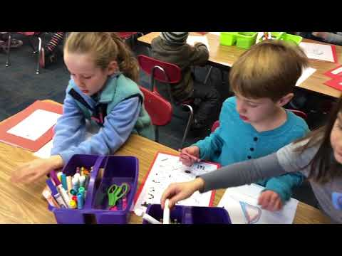
Kindergarten

Slide 5
Teaching Point
Writers of informational topics crack open their subtopics
by writing facts, definitions, details, and observations.

Slide 6
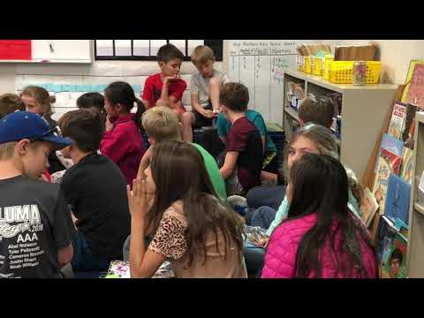
3rd Grade

Slide 7
Teaching Point
Writers of friendship topics gather ideas
by thinking of things they love to do with their friends

Slide 8
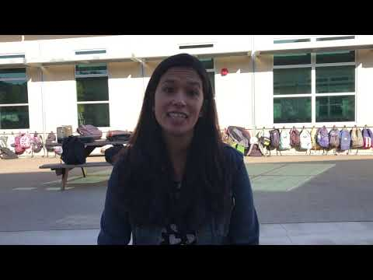
5th Grade

Slide 9
Questions? Feedback?

