Slide 1
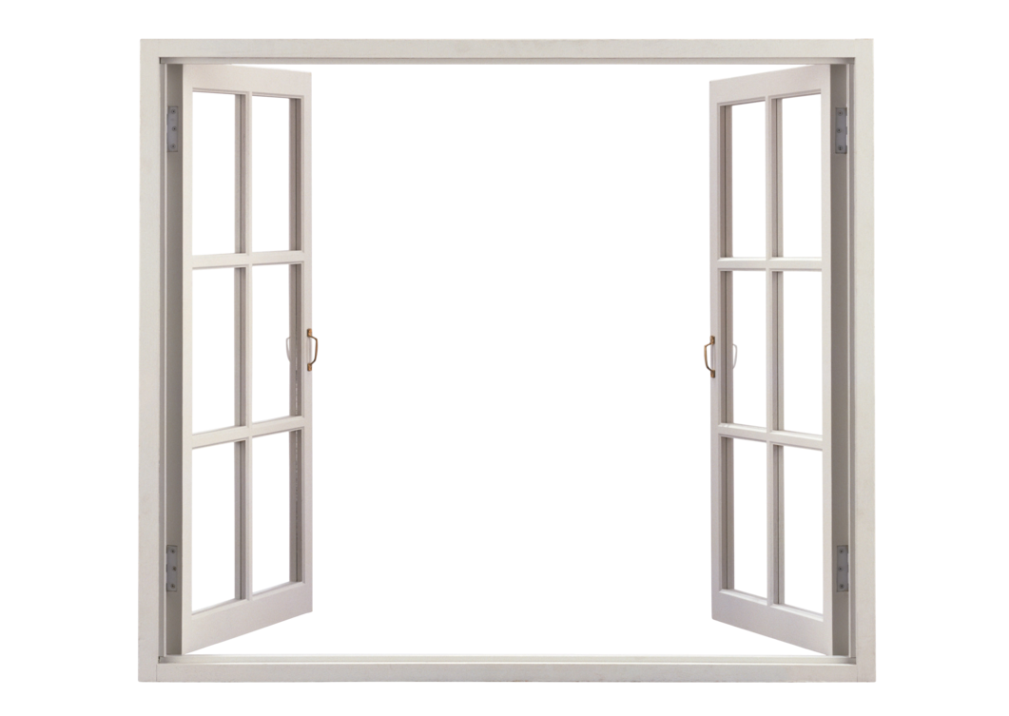
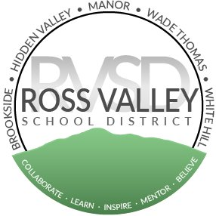
Window into Ross Valley
Mathematics: Implementation of Bridges and CPM

Slide 2
How would you solve this problem?

Slide 3
How about this one?

Slide 4
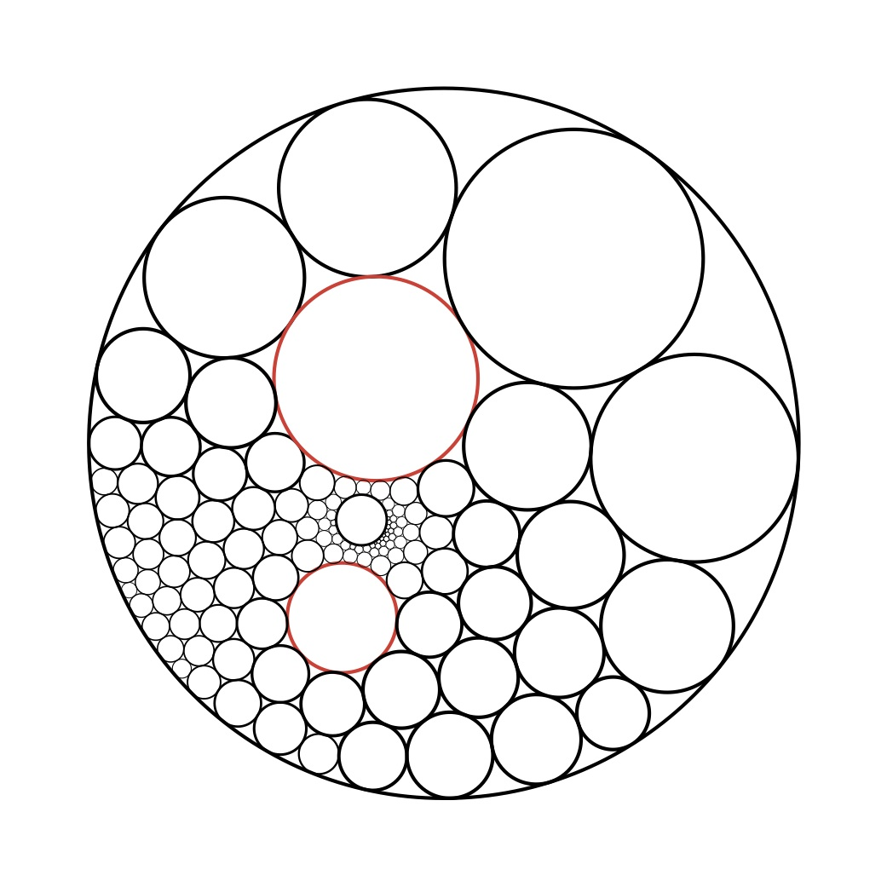
This one?
Directions: If possible, find the radius of a circle where the area of the circle and the circumference of the circle are equal. Is there more than one possible answer?

Slide 6
Goal: Continue working with teachers on how to raise the DOK within regular mathematics instruction.

Slide 7
Window into Ross Valley
Purpose: To provide an opportunity for the board and public to see the impact of district initiatives on teaching and learning.

Slide 8
Ross Valley School District Math Agreements
Learning is focused on mathematical thinking.
Conceptual understanding is used to build procedural fluency.
Math tasks and activities create productive struggle for all students.
Classroom activities promote student enjoyment and appreciation of math.
Evaluation of students allows for mistakes and multiple opportunities to show growth.

Slide 9
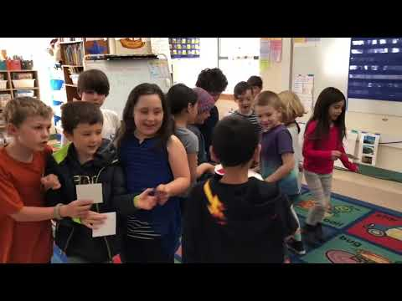
1st Grade with Ms. Julie’s Class

Slide 10
Ross Valley School District Math Agreements
Learning is focused on mathematical thinking.
Conceptual understanding is used to build procedural fluency.
Math tasks and activities create productive struggle for all students.
Classroom activities promote student enjoyment and appreciation of math.
Evaluation of students allows for mistakes and multiple opportunities to show growth.

Slide 11
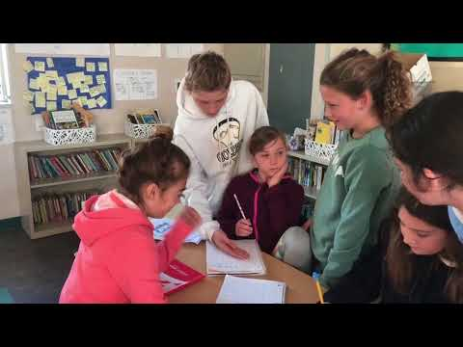
5th Grade with Ms. Rudden’s Class

Slide 12
Ross Valley School District Math Agreements
Learning is focused on mathematical thinking.
Conceptual understanding is used to build procedural fluency.
Math tasks and activities create productive struggle for all students.
Classroom activities promote student enjoyment and appreciation of math.
Evaluation of students allows for mistakes and multiple opportunities to show growth.

Slide 13
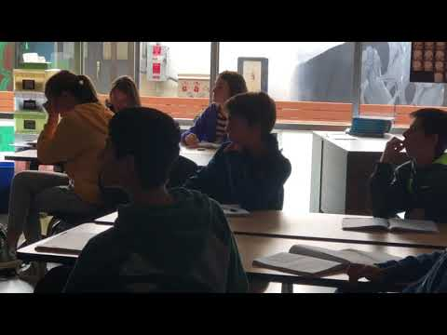
7th Grade with Ms. DeTore’s Class

Slide 14
Flexible Seating in Action!
Socratic Dialogue in the Middle School!

